Slide 1
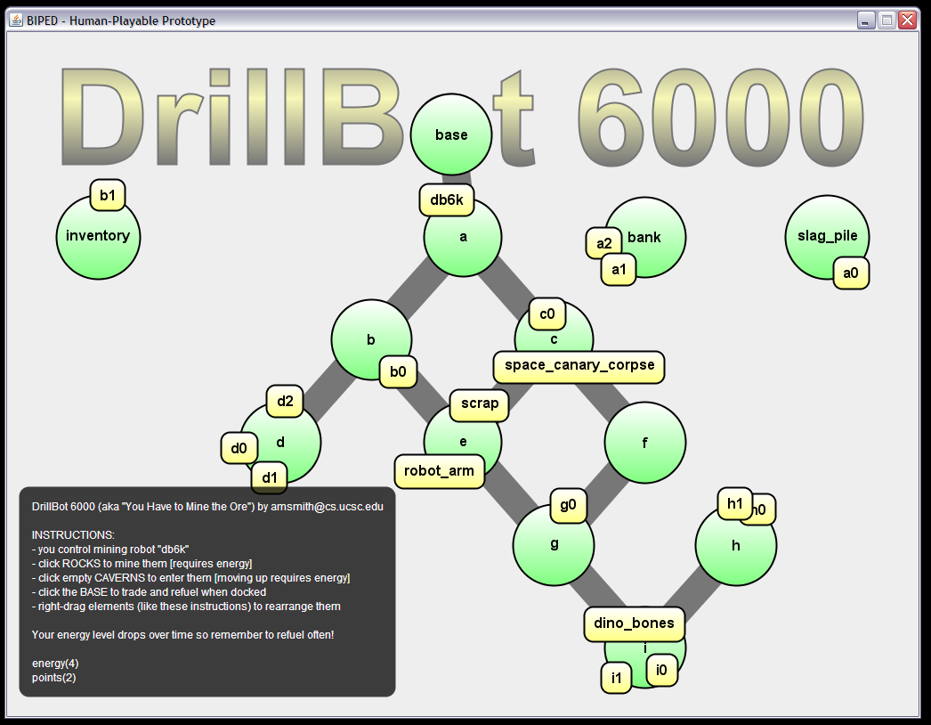
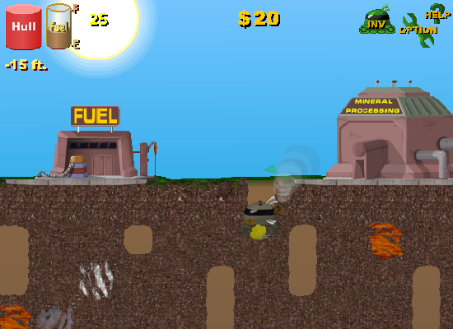
Computational Support for Playtesting Game Sketching
Adam M. Smith Mark J. Nelson Michael Mateas
amsmith@cs.ucsc.edu mnelson@cc.gatech.edu michaelm@cs.ucsc.edu
Research Question
Problem: Excessive effort makes exploring new design difficult, inhibiting creativity. How do we give game designers access to rich backtalk from their designs without requiring too much effort?
Solution: Take a single game definition in our game-sketching language and compile this sketch into a human-playable game as well as a formal rule system. The playable game can be used for traditional play testing with the designer or her friends, and the formal rule system allows machine play testing (solving for play traces that meet interesting criteria).
System Architecture
Sketch Language
% game mechanics
game_state(position(P)) :- pos(P).
game_event(up_to(P)) :- pos(P).
possible(up_to(P2)) :-
holds(position(P1)),
link(P2,P1),
energized,
\+ occupied(P2).
initiates(up_to(P),position(P)) :- pos(P).
terminates(up_to(P2),position(P1)) :-
pos(P1), pos(P2),
holds(position(P1)).
initially(position(base)).
pos(base).
pos(a).
link(base,a).
% ui bindings
ui_space(P) :- pos(P).
ui_token(db6k).
ui_location(db6k,P) :-
holds(position(P)).
ui_triggers(ui_click_space(P),up_to(P)).
ui_layout(base,0.4875,0.15).
Designer
%-- Answer: 6
happens(mine(a1),0).
happens(drain,1).
happens(drain,2).
happens(trade,3).
happens(mine(a2),4).
happens(mine(a0),5).
happens(down_to(a),6).
happens(mine(canary),7).
happens(mine(c0),8).
happens(down_to(c),9).
happens(down_to(f),10).
happens(up_to(c),11).
happens(up_to(a),12).
happens(down_to(c),13).
happens(up_to(a),14).
Analysis Engine
Game Sketch
Game Engine
constraints and queries
Formal Rule System
Playable Prototype
human subjects
Game Prototyping
Game prototypes: working models of an idea that allow the designer to test its feasibility and make improvements to it
Physical prototypes: resemble board games; use cards, dice, miniatures, hand-drawn maps, etc.; rules are informal and socially negotiable; very easy to make changes to physical prototypes (even as they are being played)
Computational prototypes: primitive versions of real video games; use a computer for enforcing rigid rules and performing automatic book-keeping; big leap from informal physical prototypes; computational prototypes are resistant to sweeping design changes
Games sketches in our system: target gray area between traditional categories; use rigid rules on computer with automatic book-keeping; map to a universal, board-game-like, graphical model; use declarative, elaboration-tolerant rule representation for improved flexibility over traditional game implementation rules
Playtesting
Self-testing: the designer tries out her own game; good for early stages when rules are still being formalized; quick iteration
Testing with friends: peers do not have access to the “ideal” in the designer’s head; give subjective feedback drawn from personal experience; may not think the same way as target audience
Testing with target audience: most accurate evaluation of a game; expensive and time consuming; highly sensitive to feel and polish (not applicable to early stage of development)
play traces implied properties exploits puzzle solutions
play traces engagement fun hesitation
Abstract play trace: When carrying out “machine play testing” the designer can ask our analysis engine to find abstract play traces such as the trace pictured above that show certain properties. Each line describes a game event happening at a particular point in the game’s logical timeline.
Constraints help a designer focus traces on interesting behavior (such as “trading in at least six rocks without ever refueling”).
A common language syntax is used for the original game definition, the designer-specificed trace constraints and queries, and the resulting traces.
Design Insight
System architecture: Using our system, the designer supplies a single game sketch in exchange for two rich source of design backtalk. They can get backtalk from their sketch by applying constraints and queries to the formal rule system or engaging human test subjects with the playable prototype.
Game sketch language sample: Game designers use our declarative, logic programming language to concisely describe the mechanics and user interface of their game. In this sample we reproduce a partial sketch illustrating the movement mechanic in DrillBot 6000, both its logical core and its representation to the player in terms of board-game-like spaces and tokens.
Example Game
Evaluation (getting backtalk from DrillBot 6000)
Designer Effort
75 minutes for conception, whiteboard playtesting, and initial development
260 lines of final code in sketch language (180 for mechanics, 80 for UI bindings)
Human Play Testing
Game was fun for designers and three peers (learned that idea was promising)
One tester felt rushed by timer, easy disable action mechanic to get feedback on other properties of the game
Players focused on timed-action aspect vs. puzzle/strategy
Machine Play Testing
Original game mechanics allowed undesirable behavior that was masked by particular UI design choices (caught a future bug at design time)
Search for speed-runs revealed that human players were very cautious with energy reserves (but more serious players may find this unnecessary)
Adding a link from top to bottom of the level did not affect the ideal player much (level design could be preliminarily validated without additional human testing)
Screenshot of a game sketch: In DrillBot 6000, the player moves a mining robot through underground caverns, drilling out rocks of mixed value, while managing energy usage and periodically returning to the surface to refuel and trade items.
Inspiration: Motherload, a popular, commercial Flash game created by XGen Studios, was the inspiration for DrillBot 6000. While our sketch covered only the core mechanics, Motherload includes playfully animated graphics, upgradeable items, a large grid-map with a wide array of rock types, and a comical story.
expressiveintelligencestudio
UC Santa Cruz

